Slide 1

Who is Benjamin Flock?
An All About Me
Regarding a Humble* TDP
*Debatably

Slide 2
Background
bla bla bla bla
i’m just gonna speak off the cuff here, 3 minutes max
famous last words of a rambler

Slide 3


Work History
Summer 2019-Winter 2023: Private Coding Teacher/Lead Java Instructor
Summer 2020: Software Engineer @ White River Computing
Summer 2023: Software Engineer @ : ISSACS (IoT Lab at CWRU)
January-June 2024: Software Engineer @ WestClinTech
  also project management consulting at a startup that didn’t pay me and was not incorporated and was dissolved in May 2024 so ¯\_(ツ)_/¯
July 2024-Present: GEICO
no logo
no logo
no logo
wait wrong lizard

Slide 4
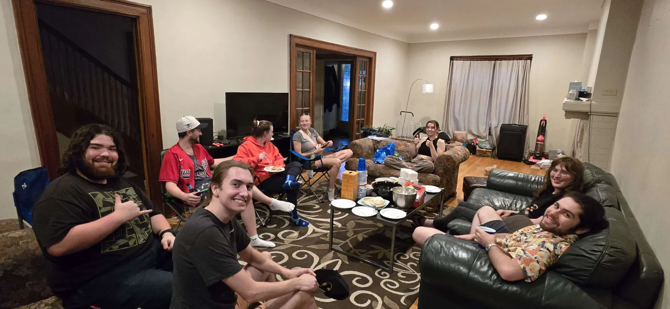
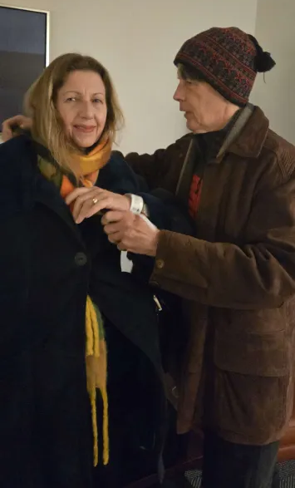
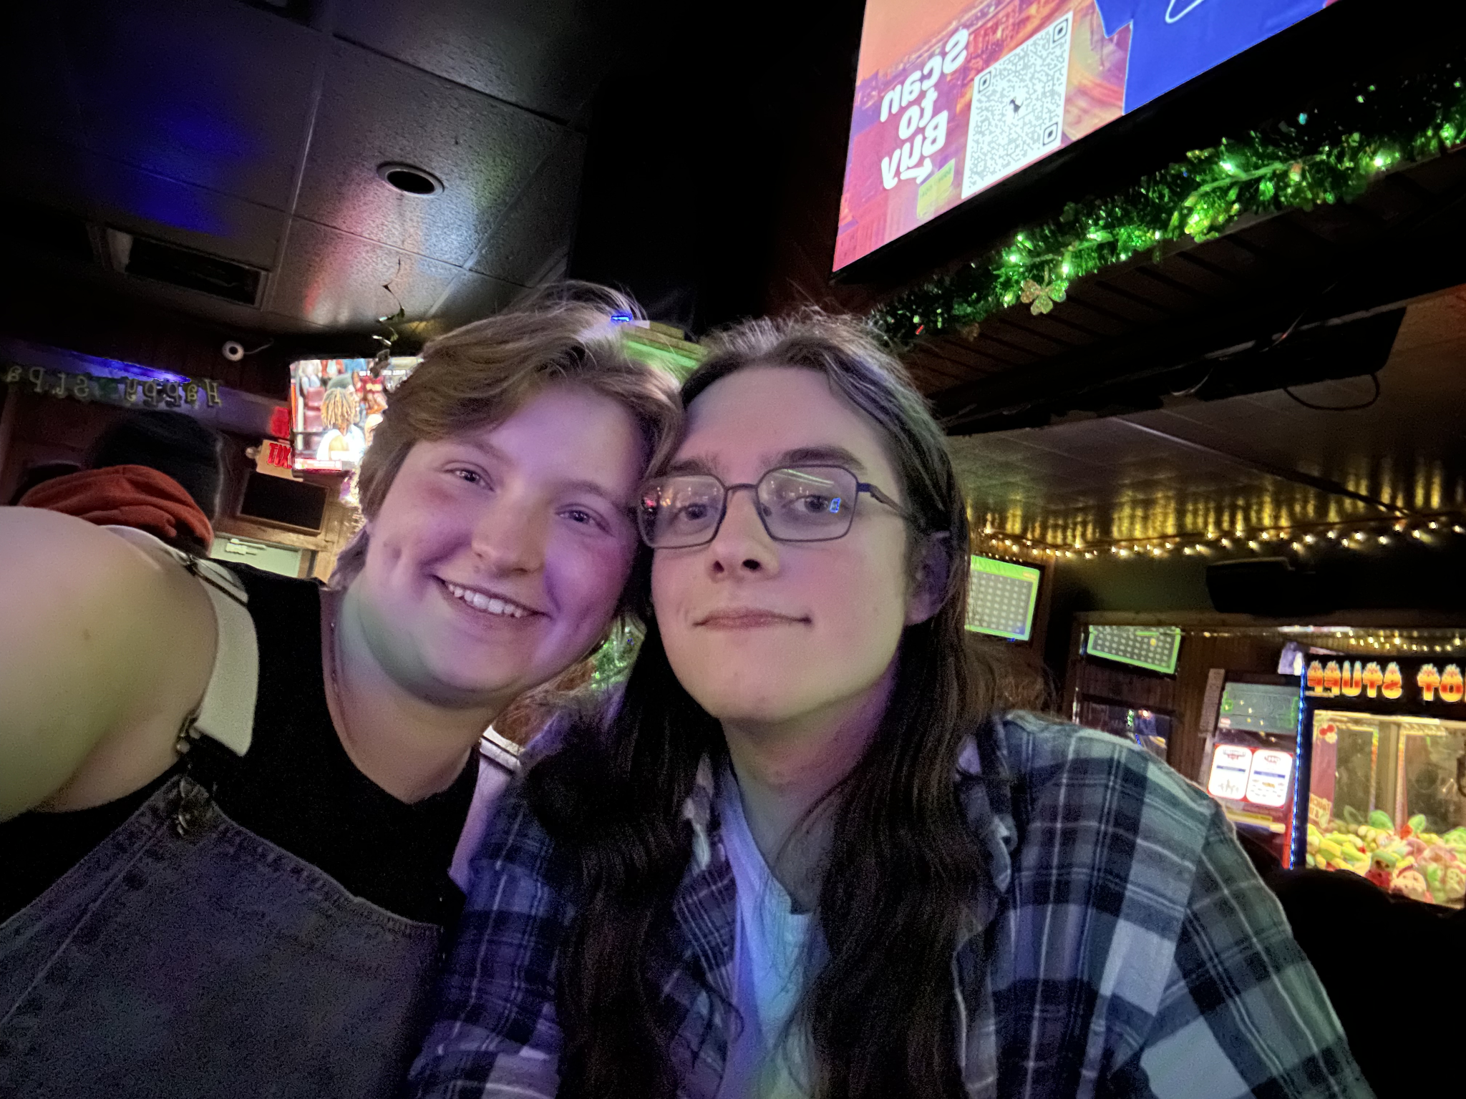
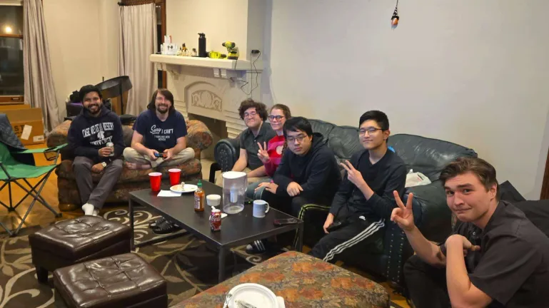
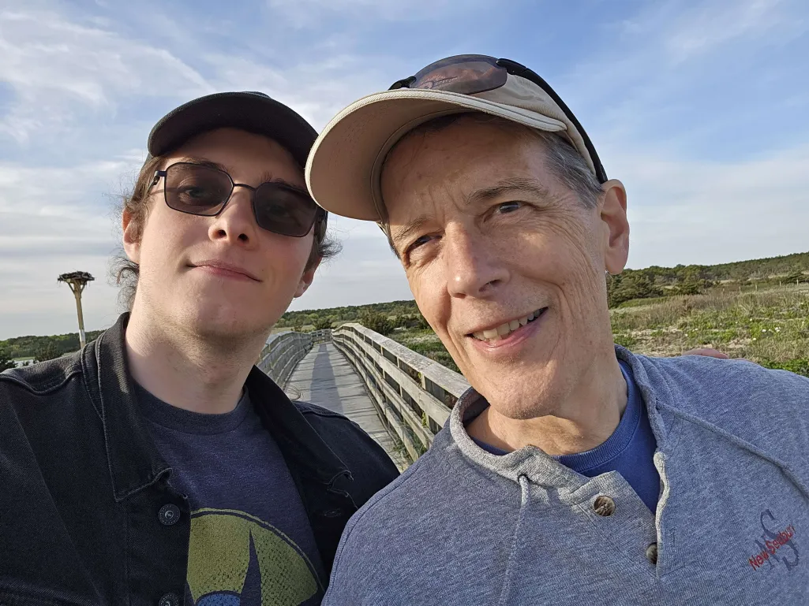
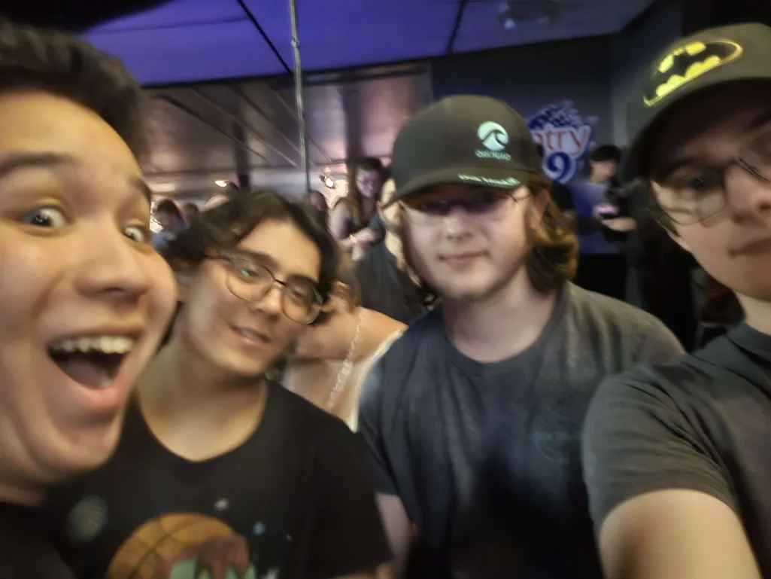
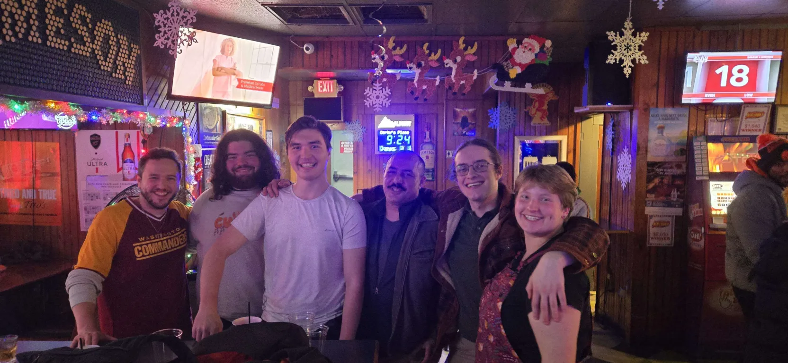
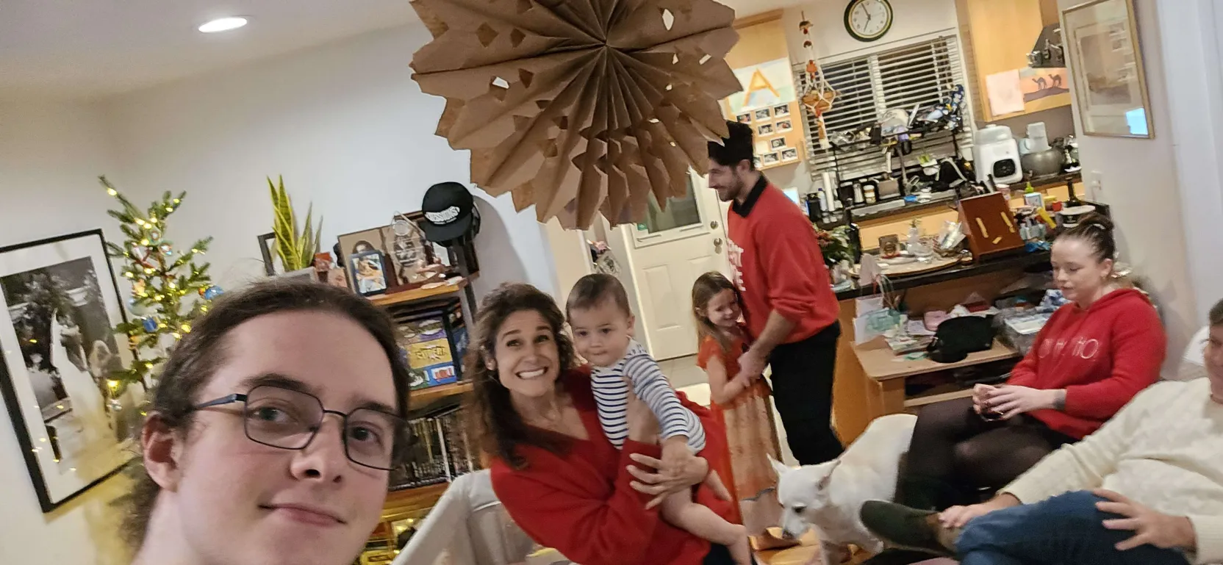
Friends and
Family
Notes:
youngest child of 12 cousins and 2 sisters, borne to the oldest of seven children

Slide 5
argh i have so few pictures of anything
i have an interesting life i promise

Slide 6
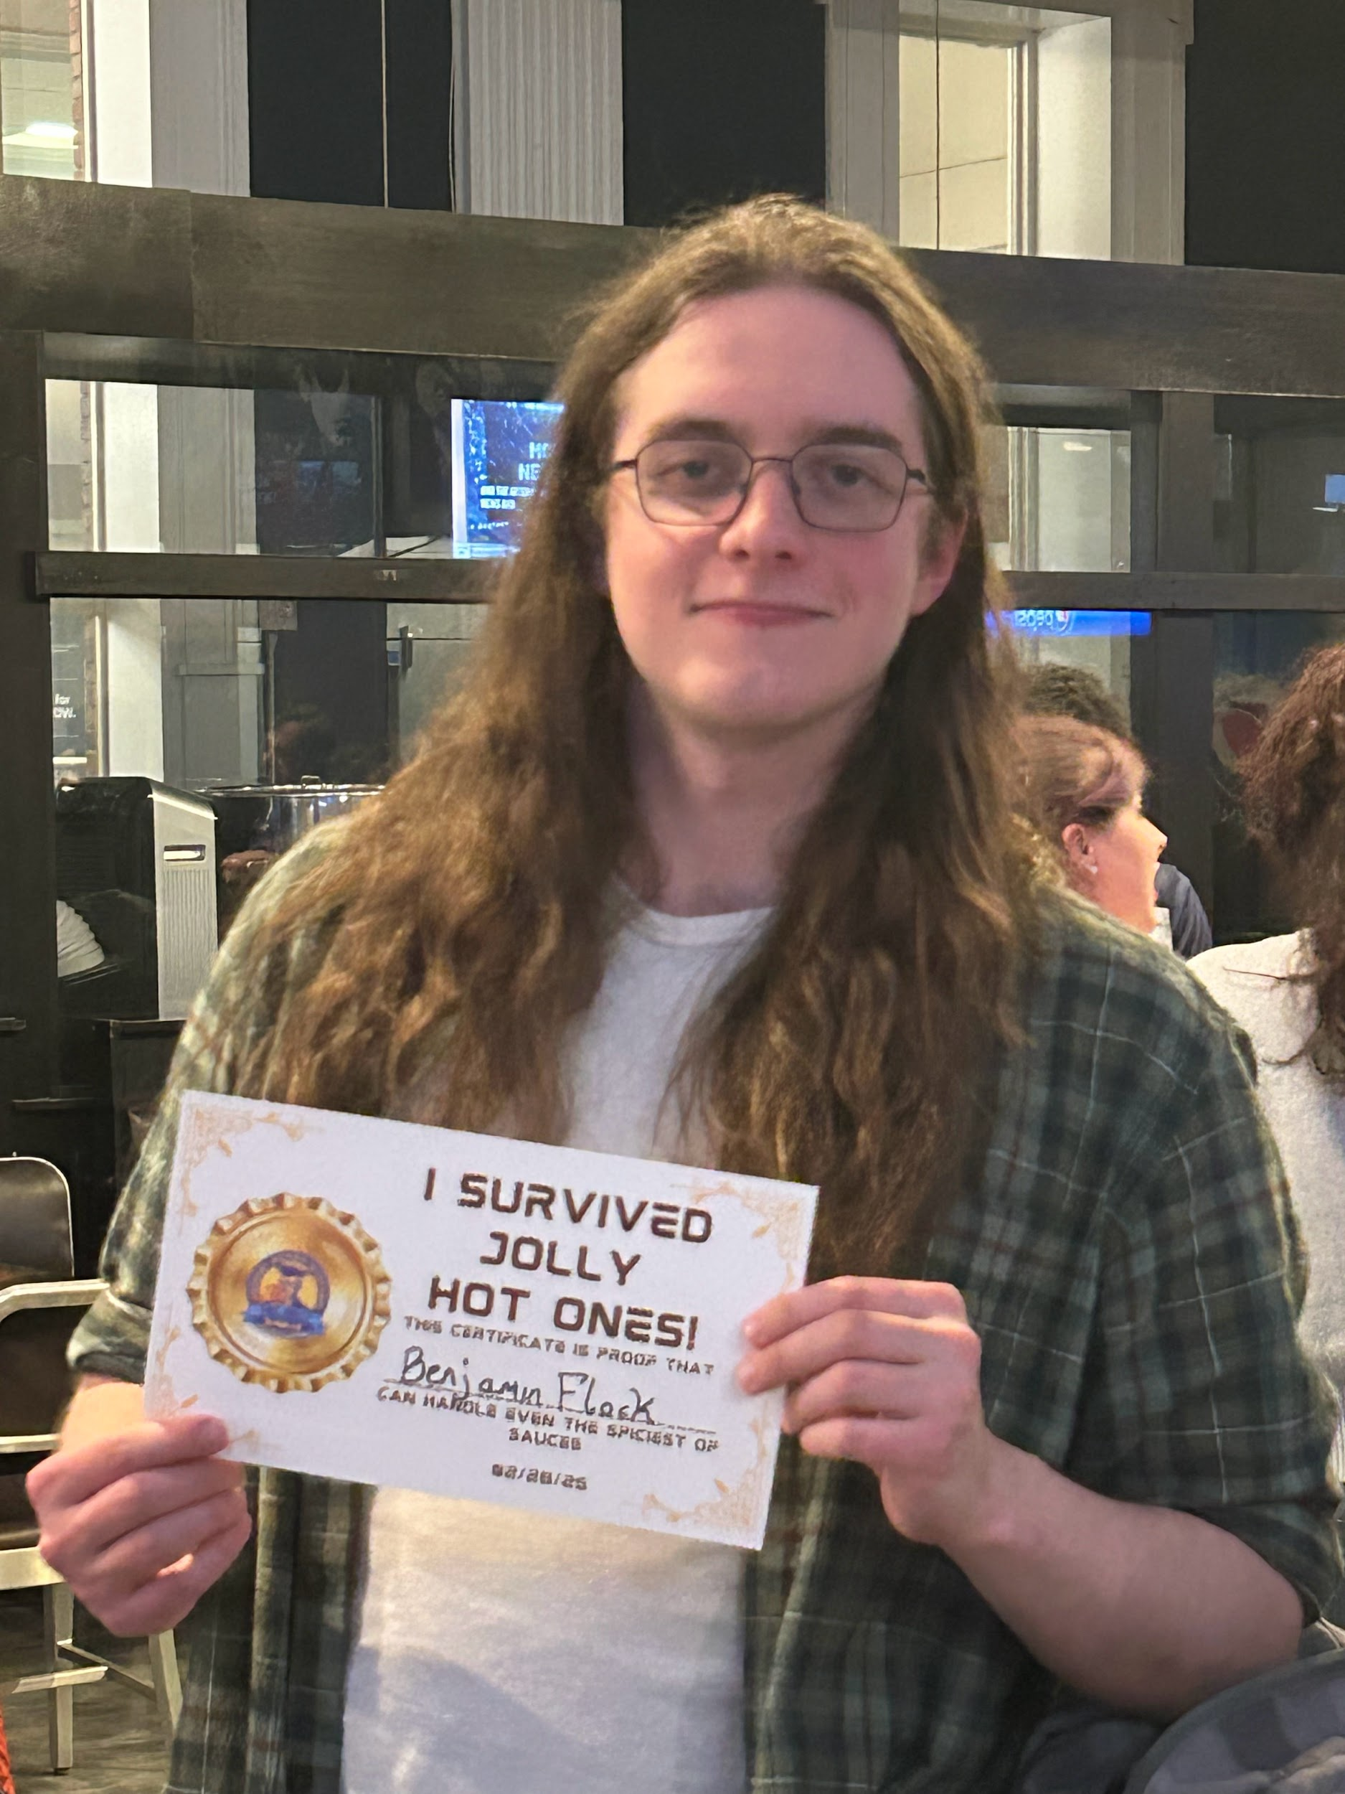
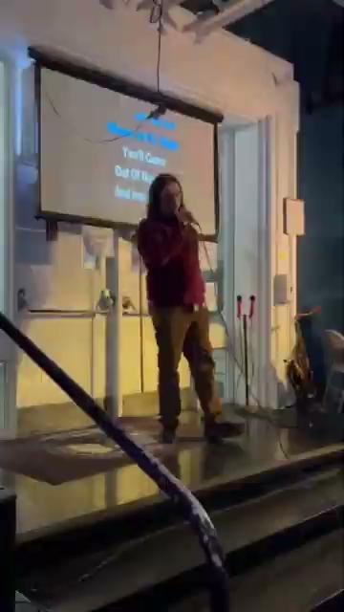
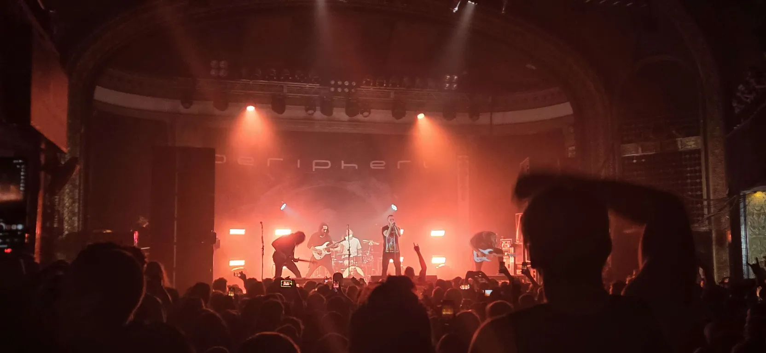
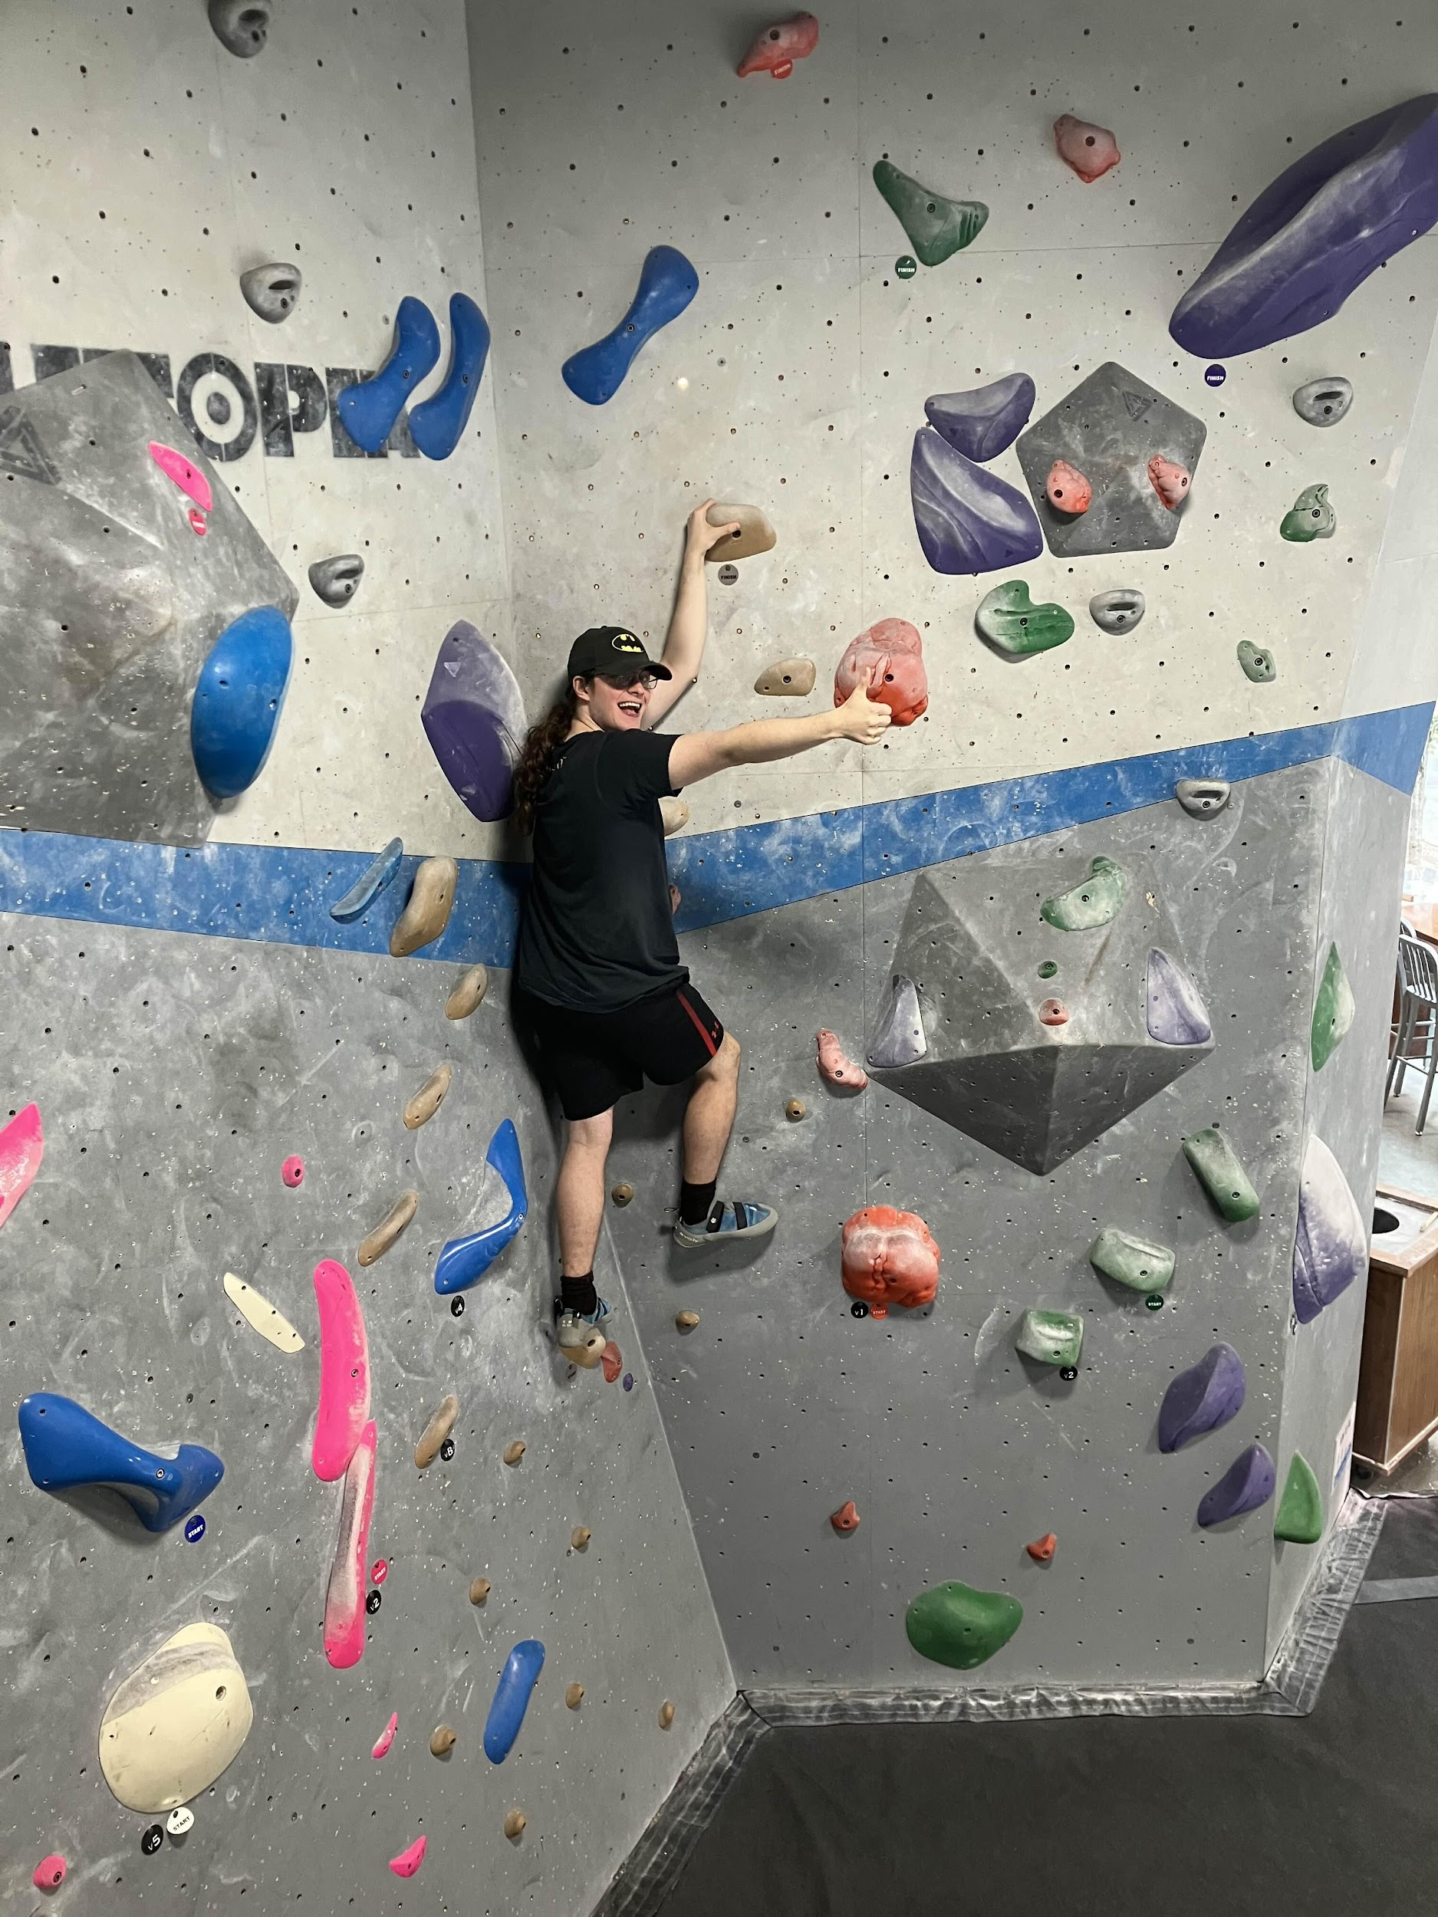
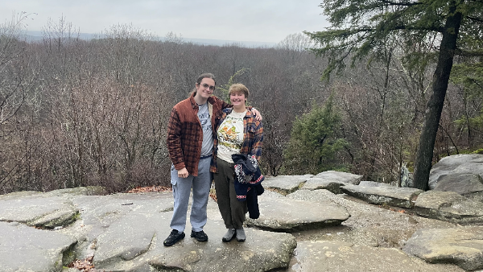
Hobbies: Going Out
karaoke

Slide 7
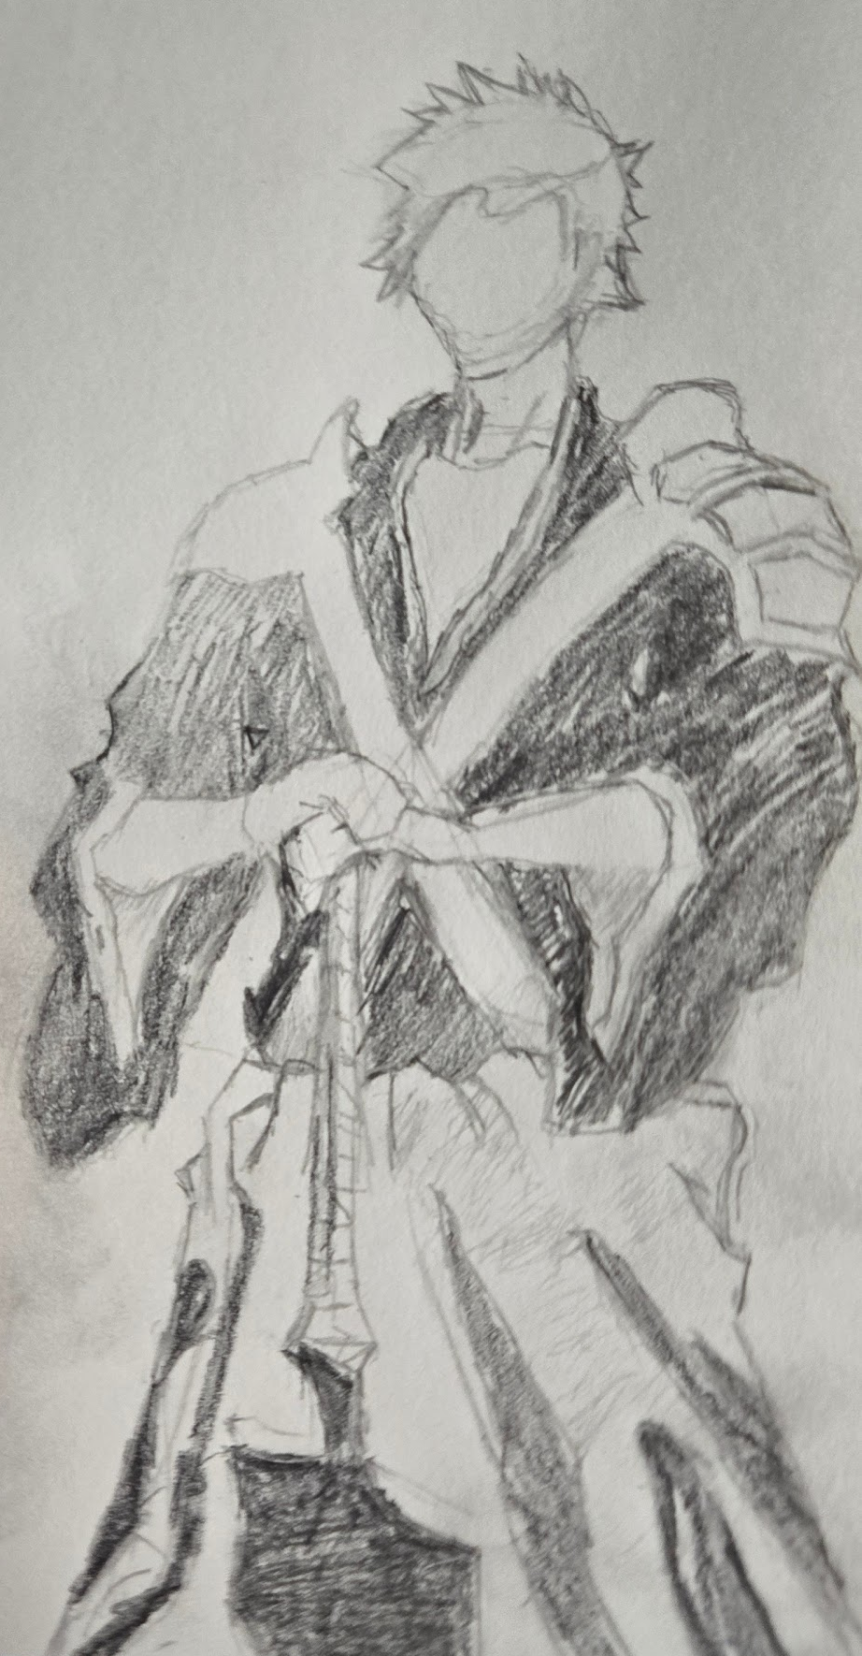
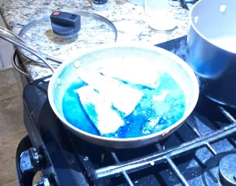
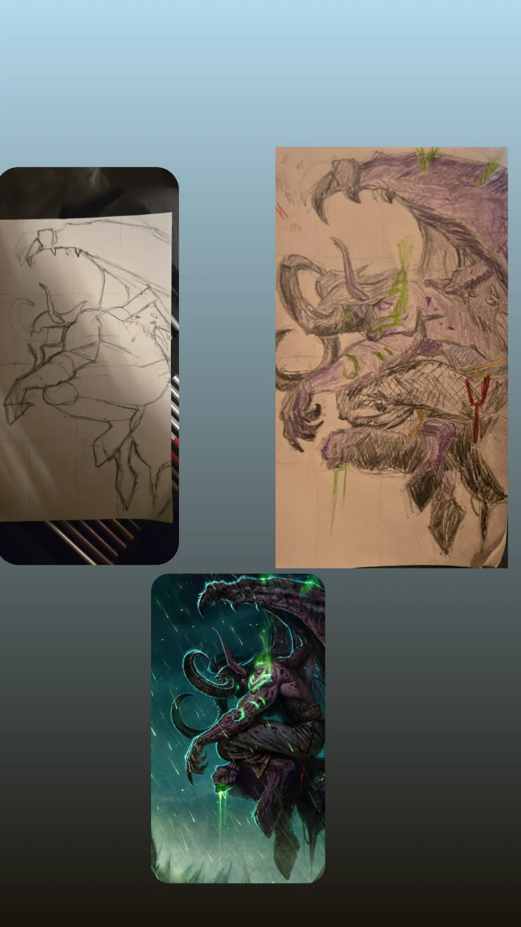
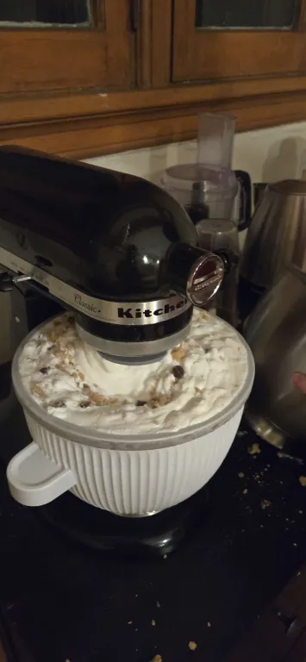
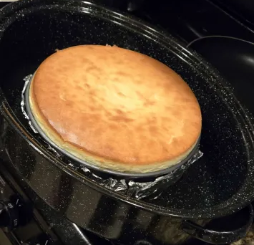
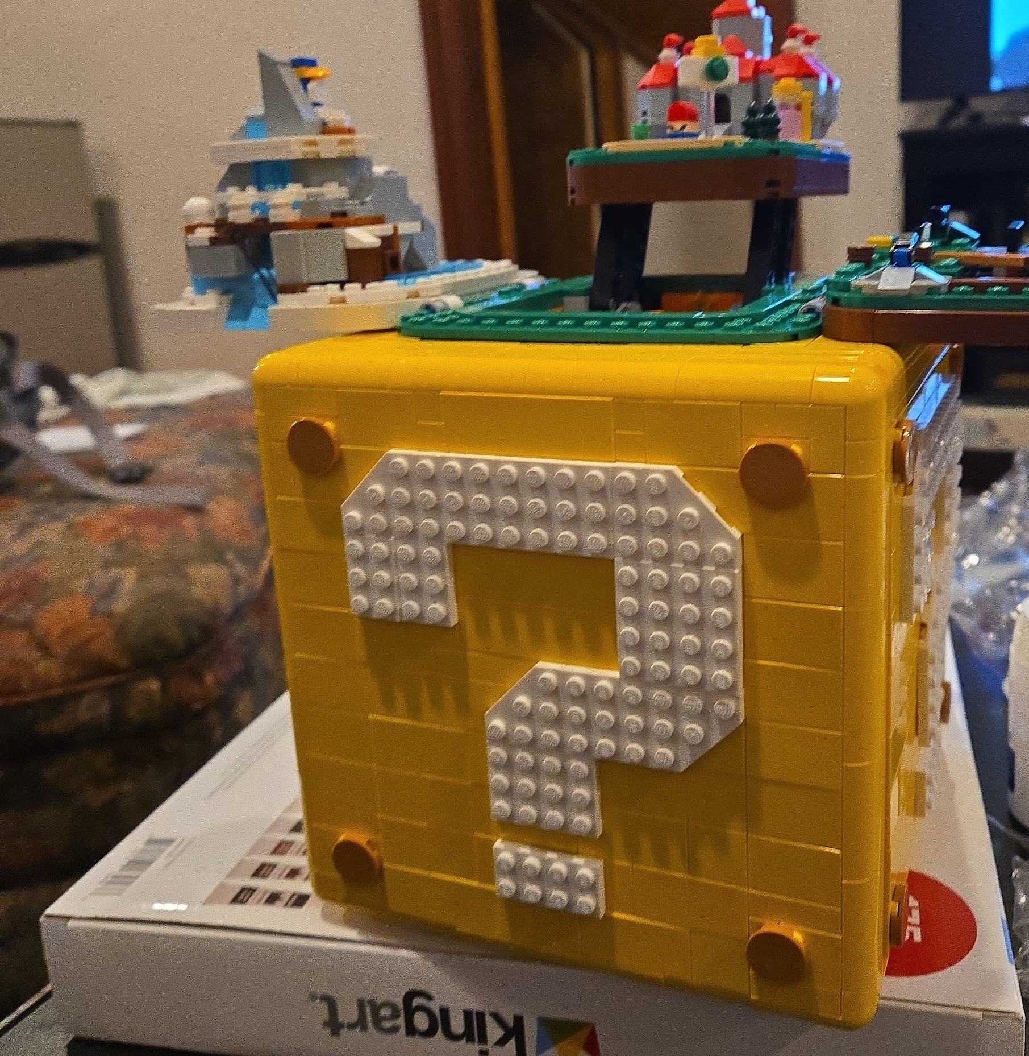

Hobbies: Staying in
lego

Slide 8
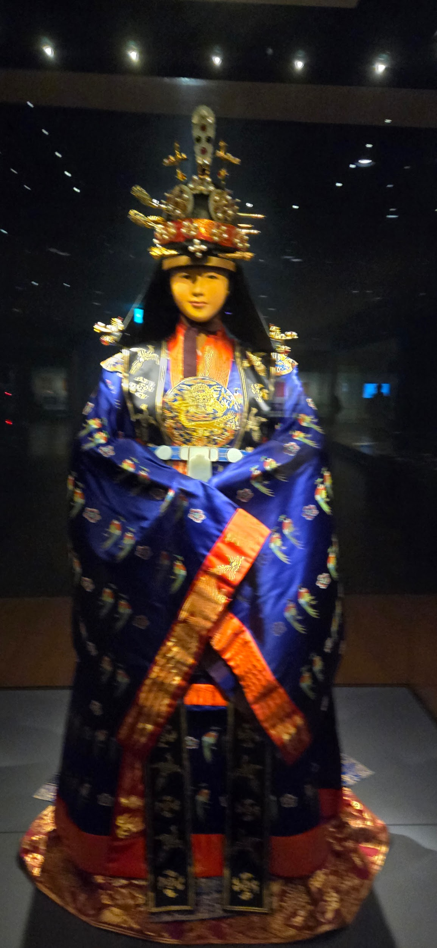
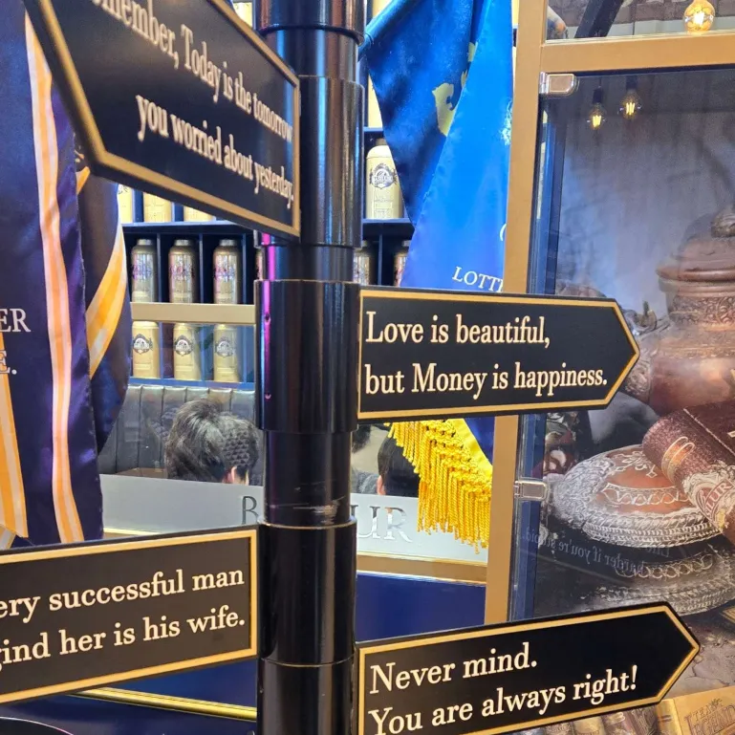
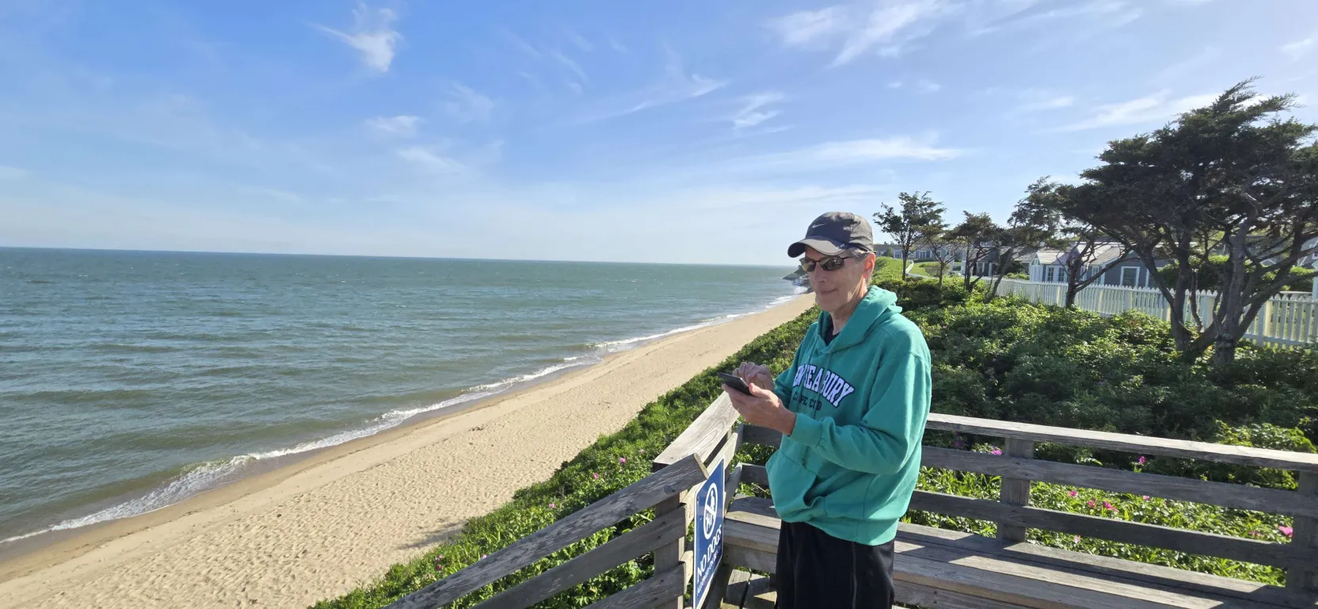


Travel

Slide 9





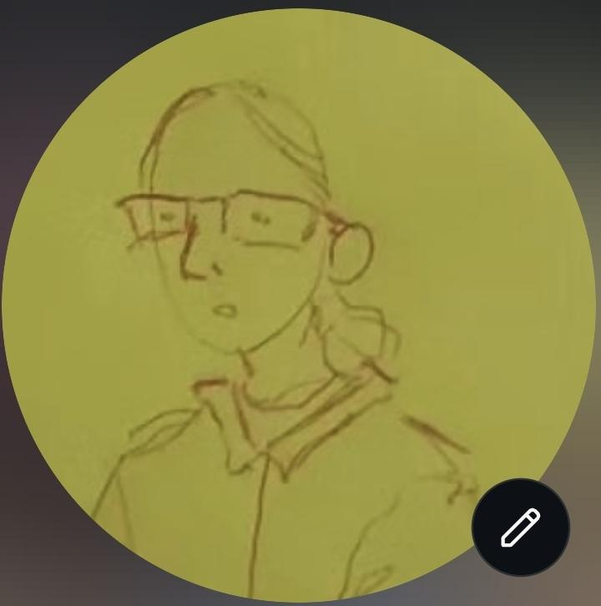


Favorites

Slide 10
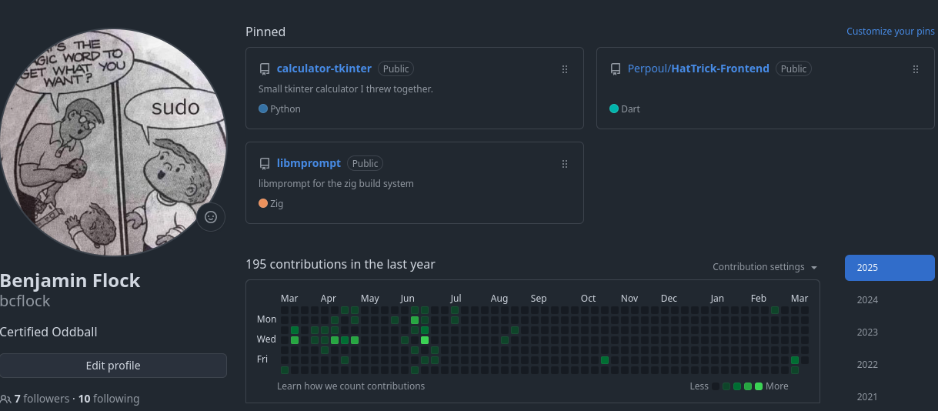
Tech Stuff I guess
Projects
  AYCB
  Fifth
  Scandal
Languages: Java, Python, SQL, Bash, Powershell
  Currently Learning: Zig, Lua
Docker, API Design, etc. etc.
Cool Projects:
  RDF to HTML (proprietary, sry)
  Big network measurement project (tons of fun)
  HPC for Brain Tumor Segmentation

Slide 11
Questions?

